Slide 1
Project Management Submitted to: Ma’am Saima
Submitted by:
Muhammad Haider
Hamaad Ali
Syed Abdullah Ashar
Muhammad Ali
Hasnat Shahid

Slide 2
Introduction:
Recent Interest in Student Performance Prediction
Increasing interest in enhancing individualized learning, resource allocation, and educational outcomes.
Overview of three popular machine learning algorithms: Support Vector Machines (SVM), Random Forests, and Linear Regression.
Emphasis on creating a user-friendly Graphical User Interface (GUI) using Tkinter for model accessibility and prediction.

Slide 3
Related Work:
Data Preprocessing:
Handling outliers, missing values, and data standardization.
Significance of data quality for predicting student achievement.
Feature Selection:
Techniques: Feature importance ratings, correlation analysis.
Citations for papers showcasing the impact of feature selection on model performance.
Predictive Modeling:
Summary of SVM, Random Forests, and Linear Regression.
Examples of effective research using these algorithms to predict student achievement.
Significance of model evaluation metrics in choosing the optimal model.

Slide 4
GUI Development:
Tkinter for User-Friendly Interfaces:
Introduction to Tkinter, a popular Python module for GUI development.
Research evidence supporting Tkinter-based interfaces for various prediction tasks.
The importance of intuitive user interfaces for model accessibility and interpretation

Slide 5
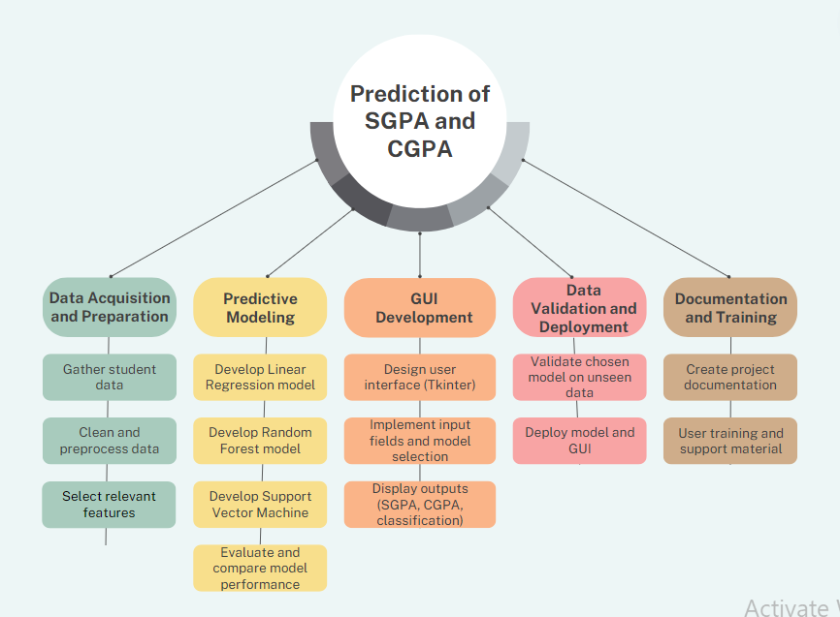
Work Breakdown Structure

Slide 6
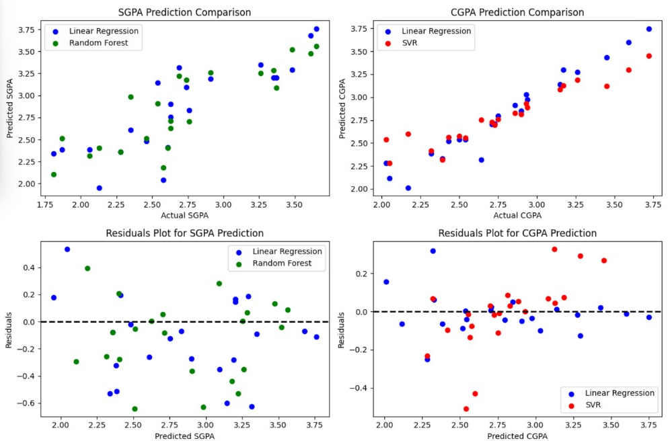
Results

Slide 7
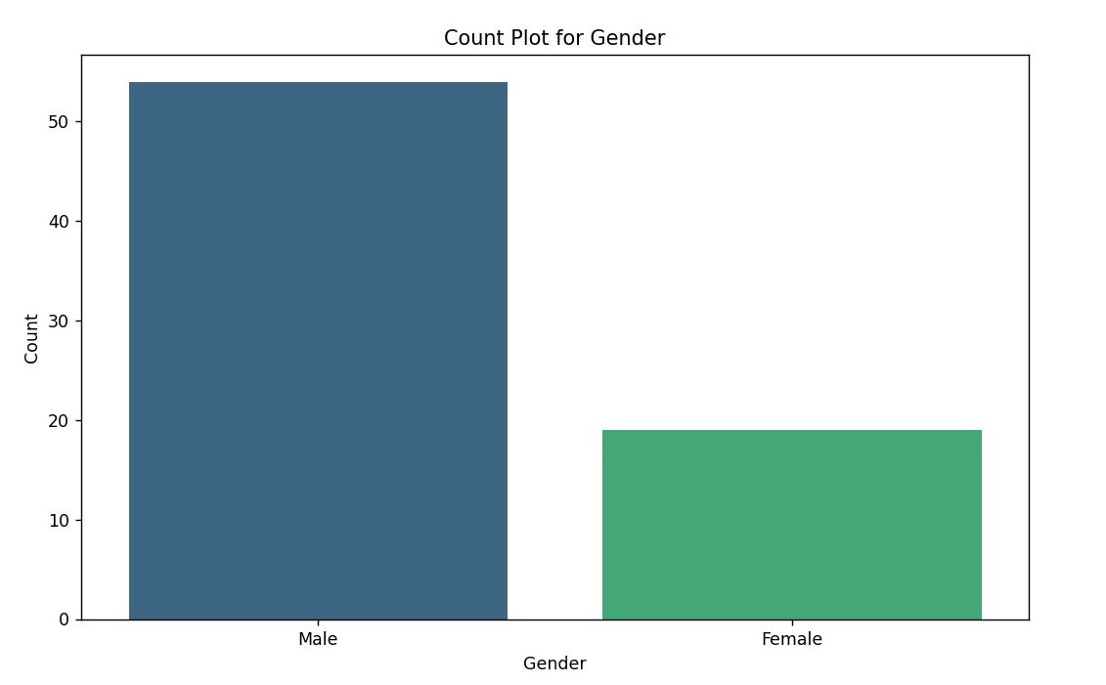
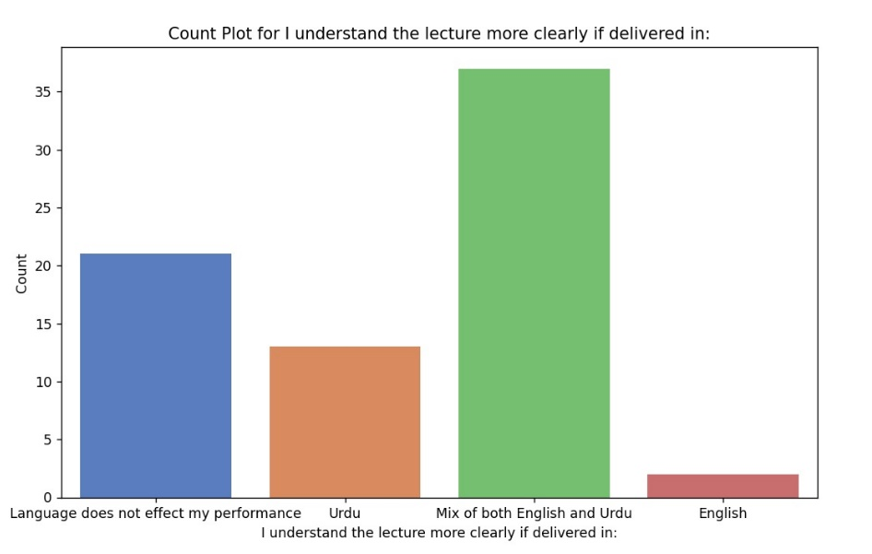
Exploratory Data Analysis (EDA):

Slide 8
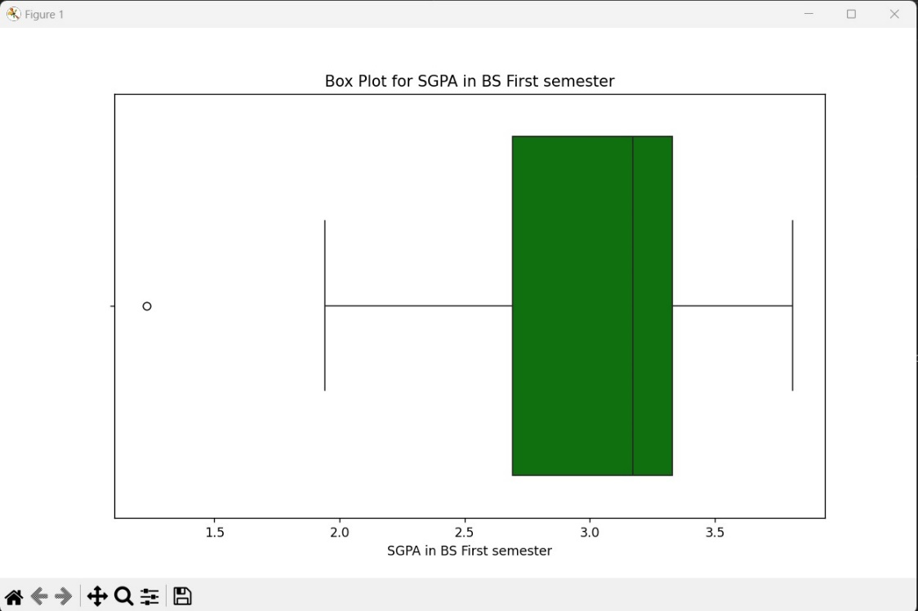
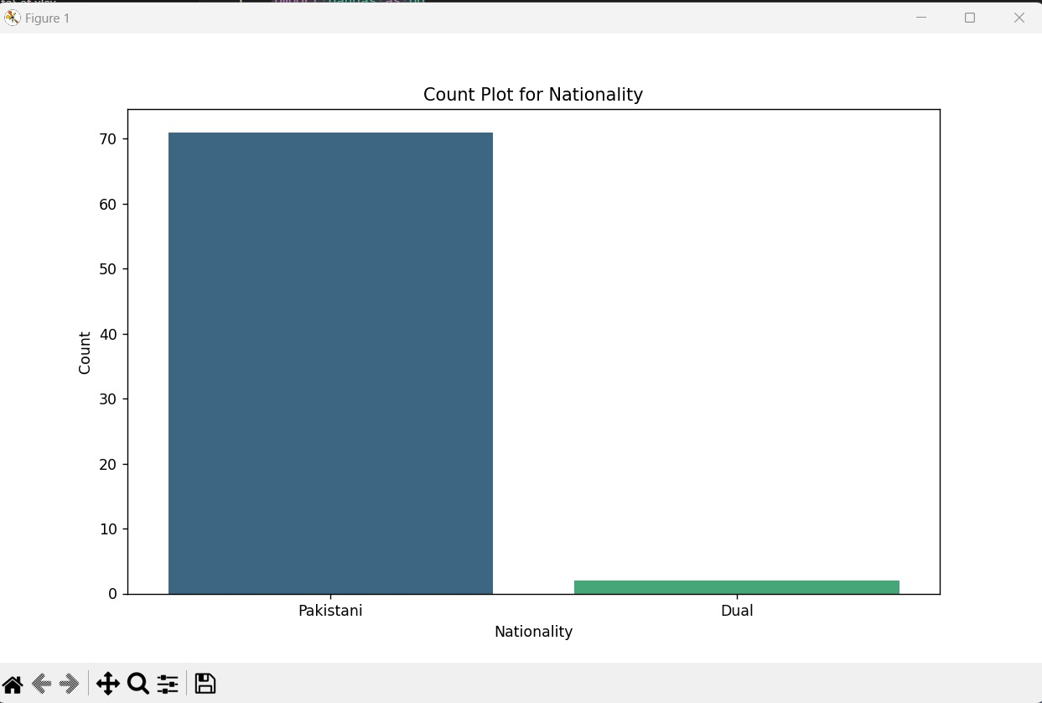
Results:

Slide 9
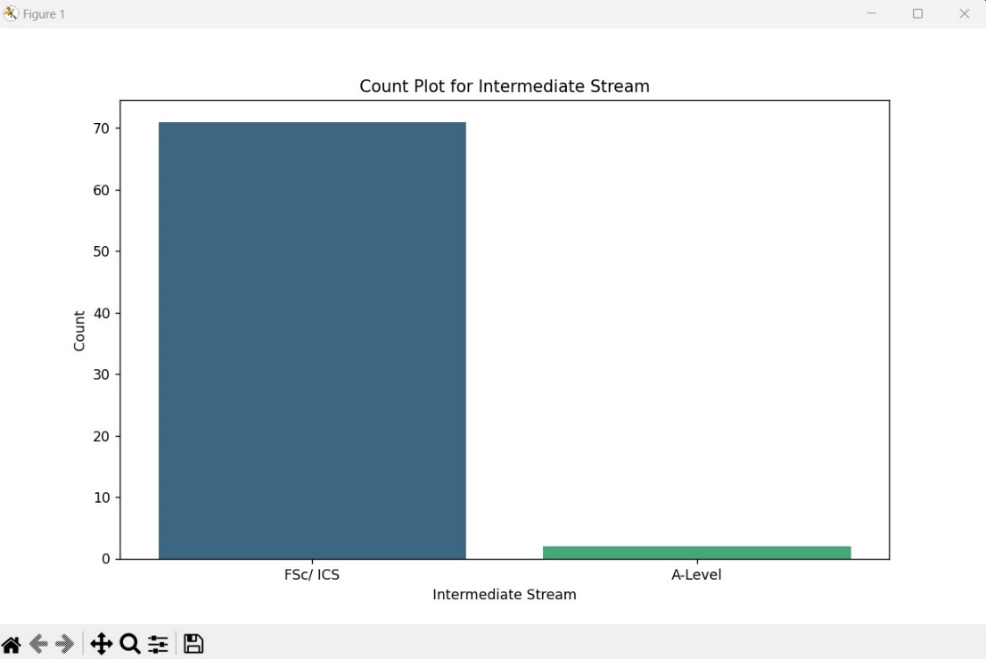
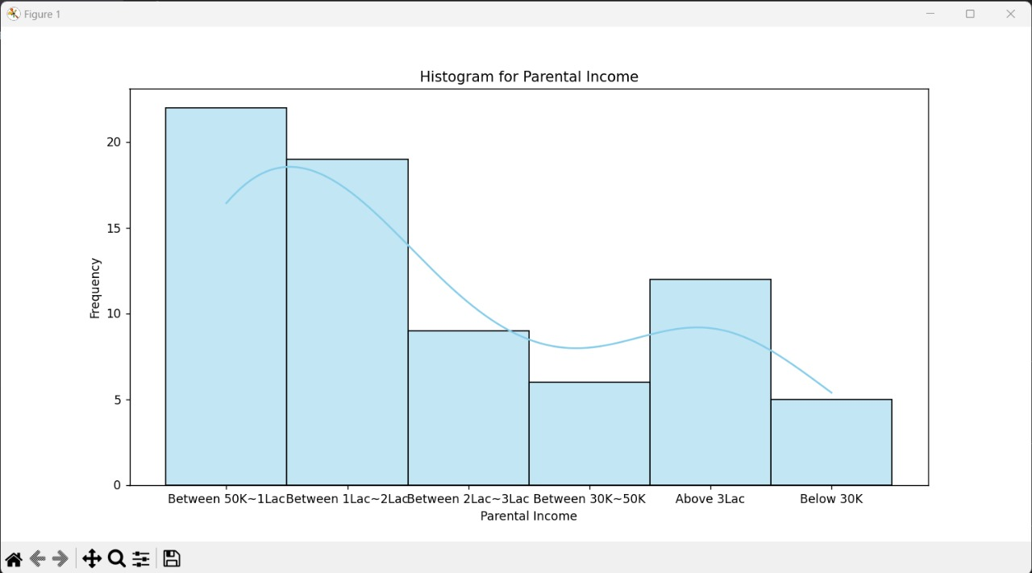
Results

Slide 10
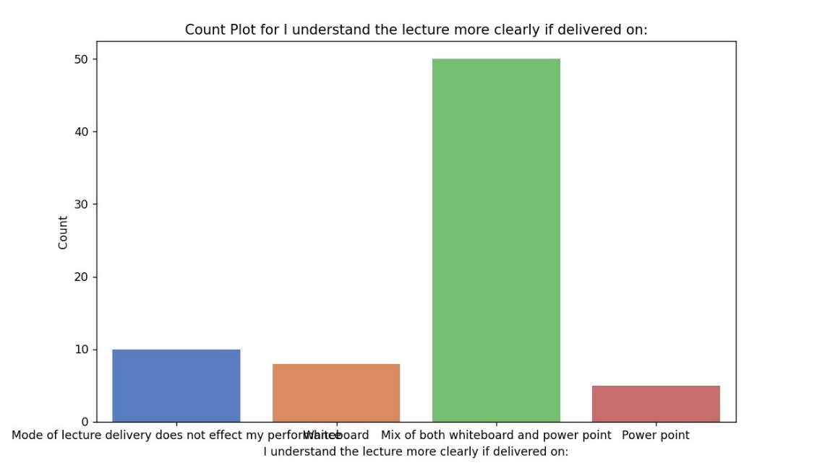
Results

Slide 11
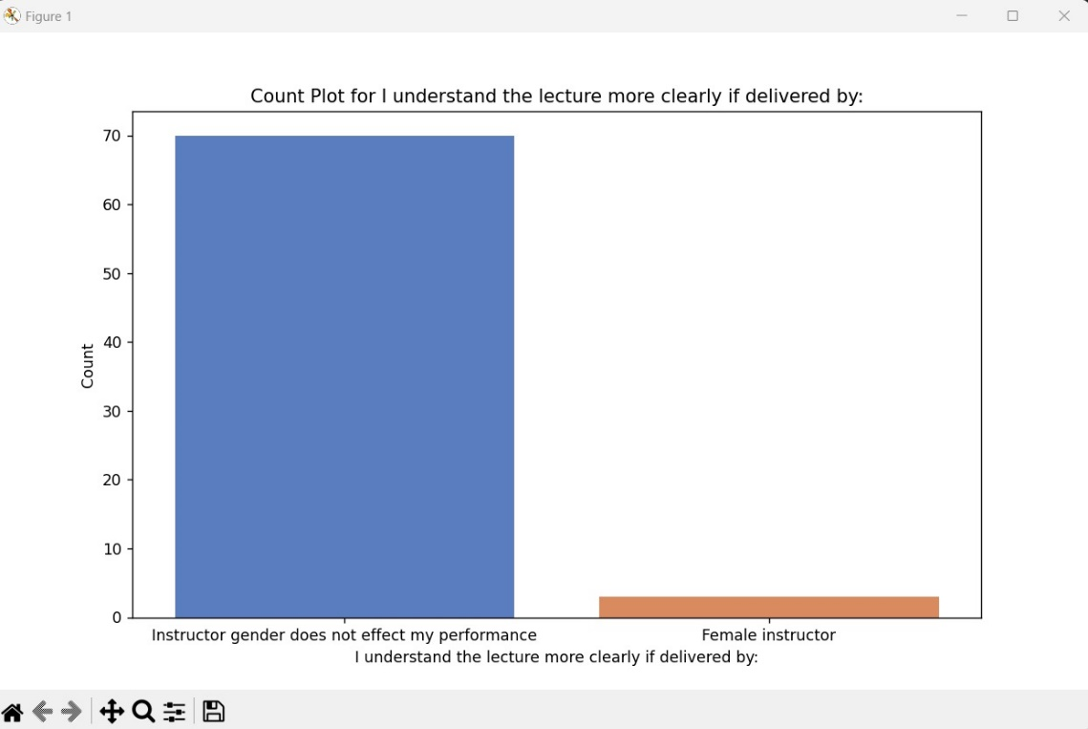
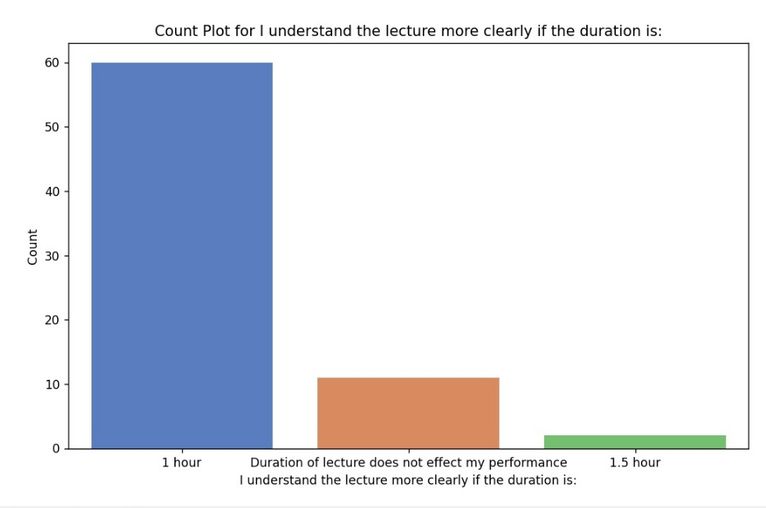
Results

Slide 12
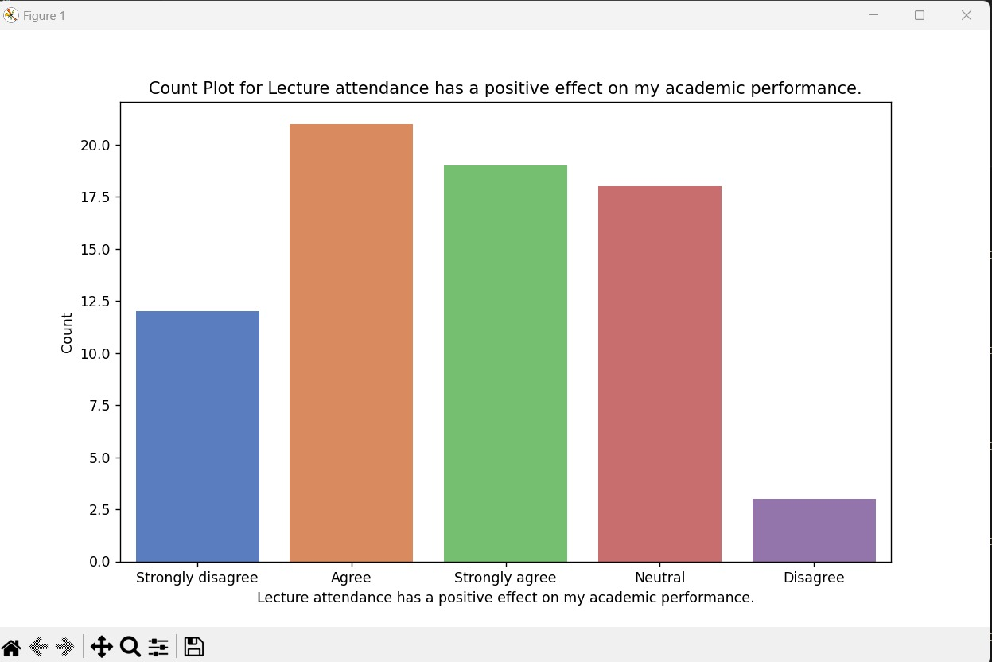
Results

Slide 13
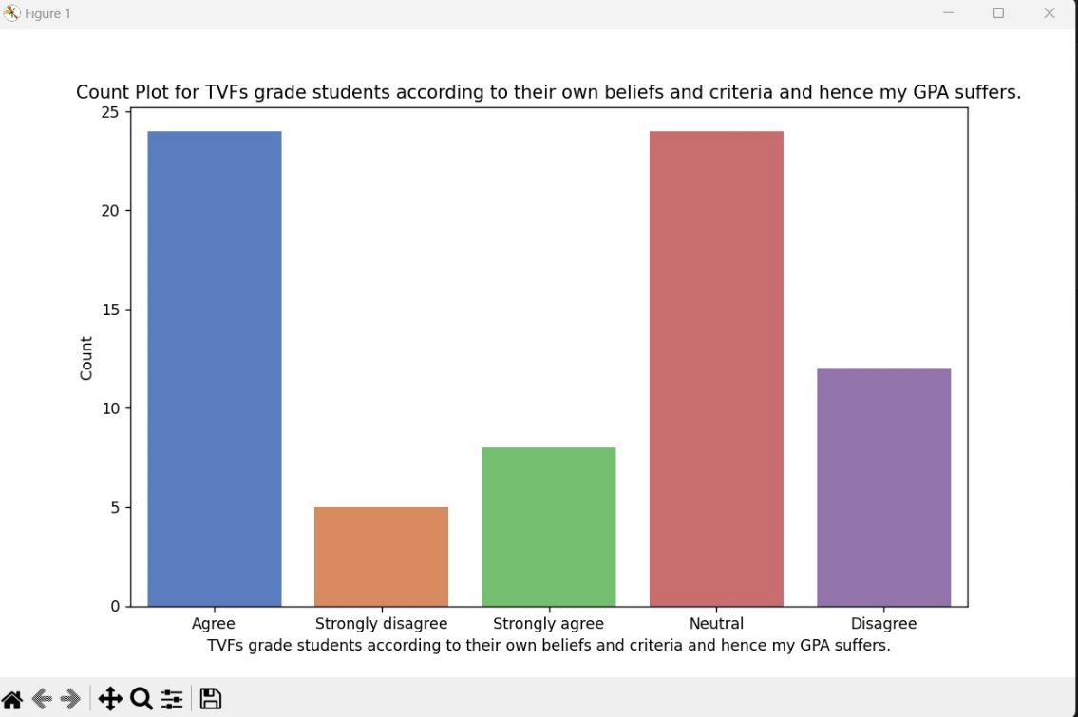
Results

Slide 14
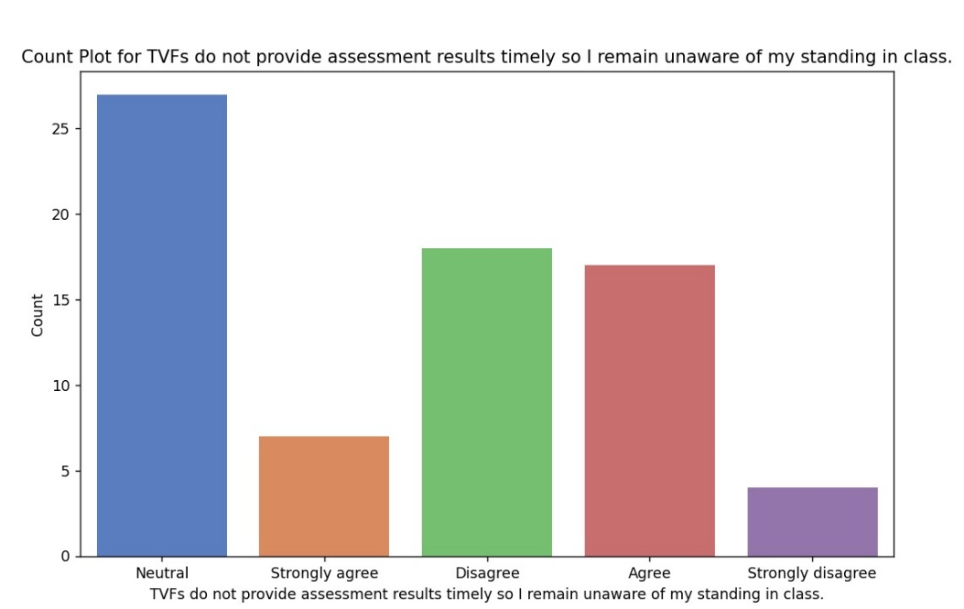
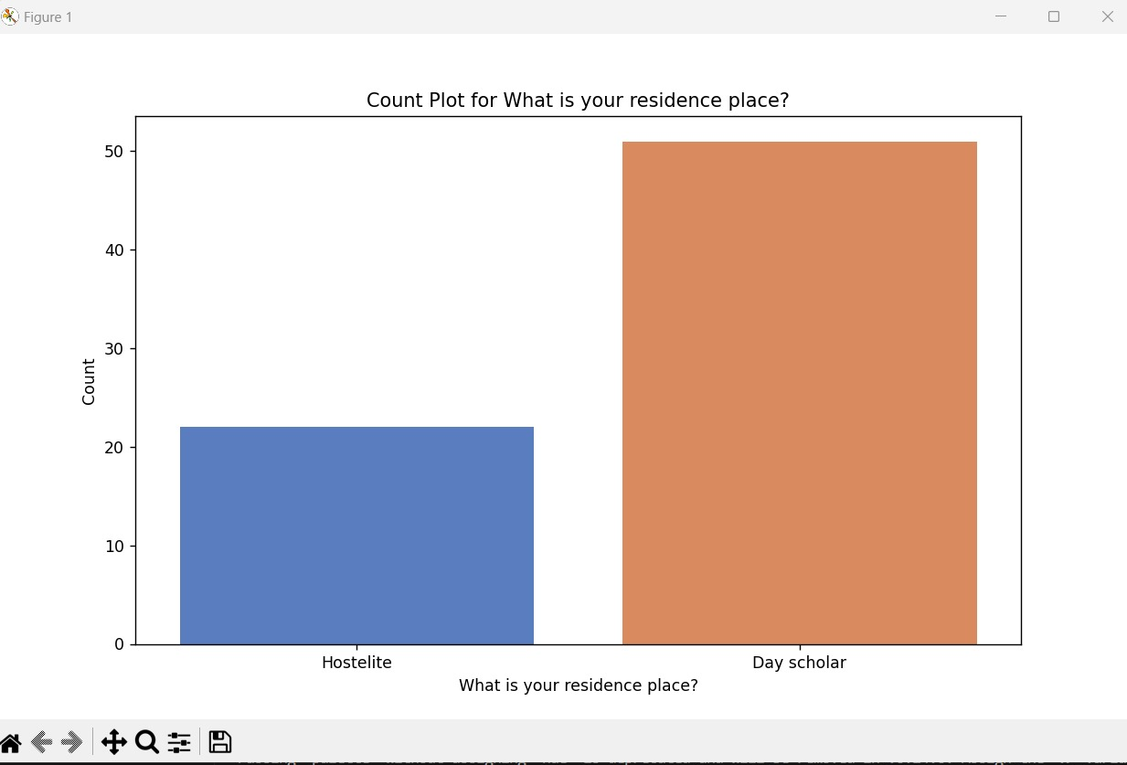
Results

Slide 15
Conclusion:
Project encompasses Data Preprocessing, EDA, and GPA Prediction GUI.
Techniques include cleaning, feature selection, and user-friendly Tkinter GUI.
Practical GPA predictions facilitated by integrated machine learning models.
Valuable for educators, researchers, optimizing educational strategies.

